Slide 1
FPGA IMPLEMENTATION OF THE TRIGONOMETRIC FUNCTION USING CORDIC ALGORITHM
Presented by-
PRIYANSHU
SUYASH MISRA
NISHA B RAJPUT
DEBANGANA MUKHERJII

Slide 2
Why CORDIC?
For implementing the trigonometric functions earlier methods used are :
1.lookup table method
2.polynomial approximation
The CORDIC method overcomes the memory requirement problem at the expense of the output latency.

Slide 3
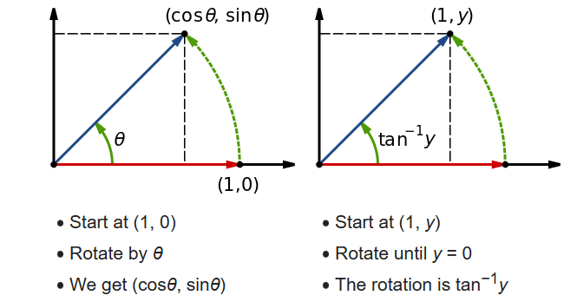
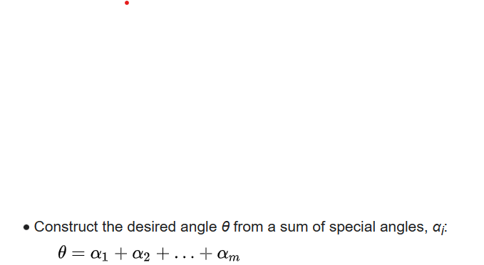
Rotation of vector

Slide 4
In the CORDIC rotation mode, the value of the angle accumulator is set to the desired angle for rotation. The direction of rotation of the coordinates at each iteration, depends on the sign of the angle accumulator. In the rotation mode, the direction of rotation is given below
di= -1 zi<0 otherwise
di=1 zi>0
In the CORDIC vectoring mode, the input vector is rotated to align with the resultant vector. The vectoring mode operates by minimizing the y component vector at each iteration . The sign of the y component decides the direction of the movement of the vector. In the vectoring mode,
the direction of rotation is given below
di= 1 yi<0 otherwise
di=-1 yi>0

Slide 5
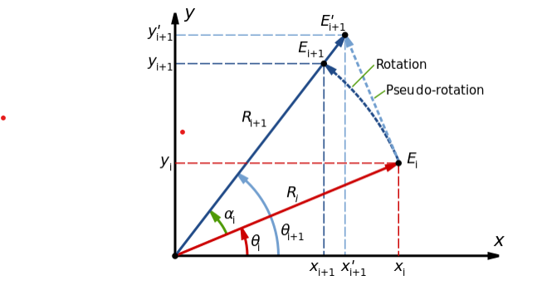
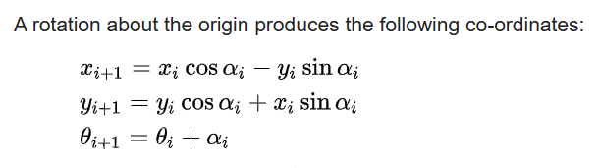
Rotations and Pseudo-Rotations

Slide 6
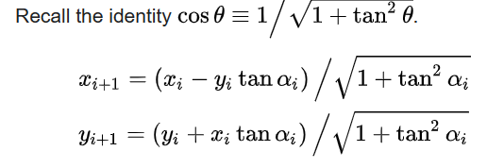


Scaling Factor K

Slide 7
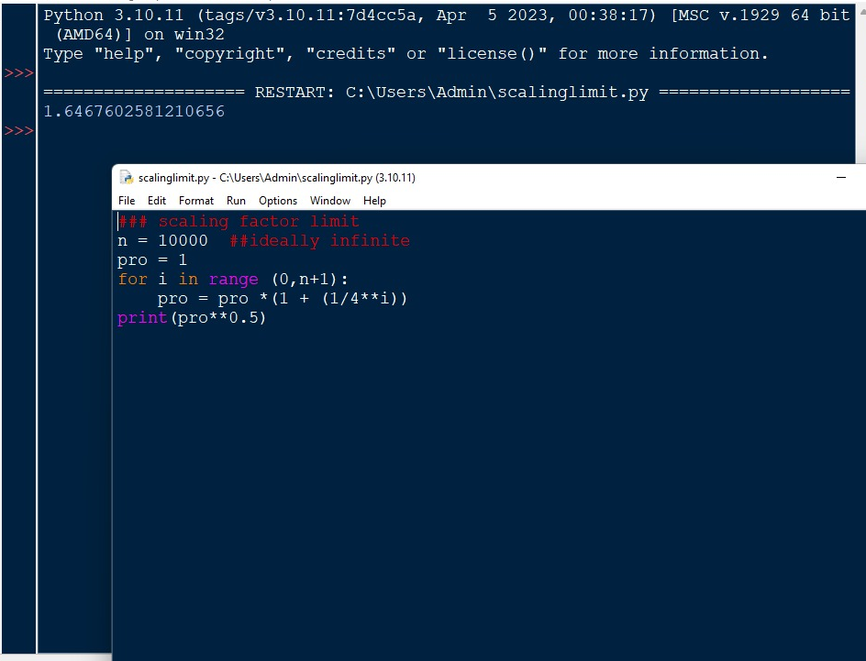
Experimentally verified value of K

Slide 8
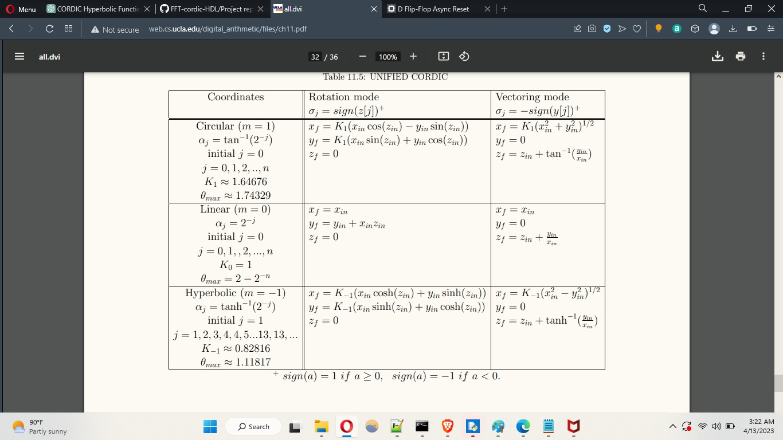
GENERALISED ROTATIONS

Slide 9
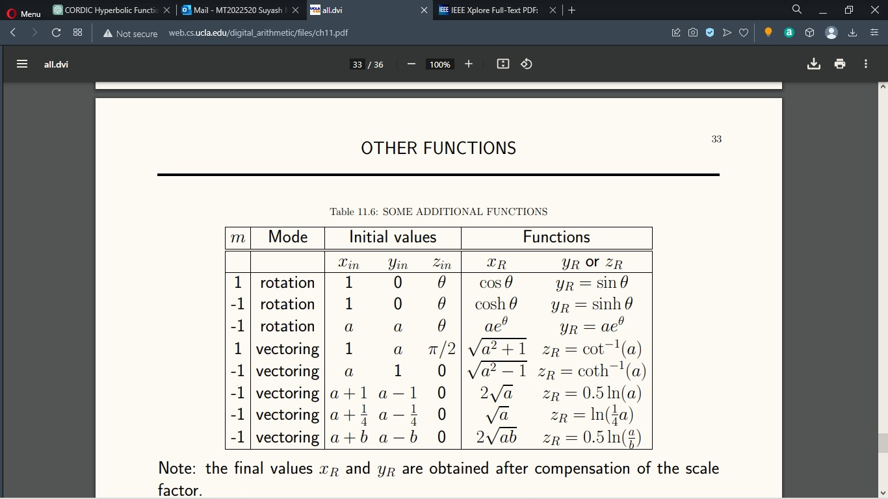
Functions related to different mode

Slide 10
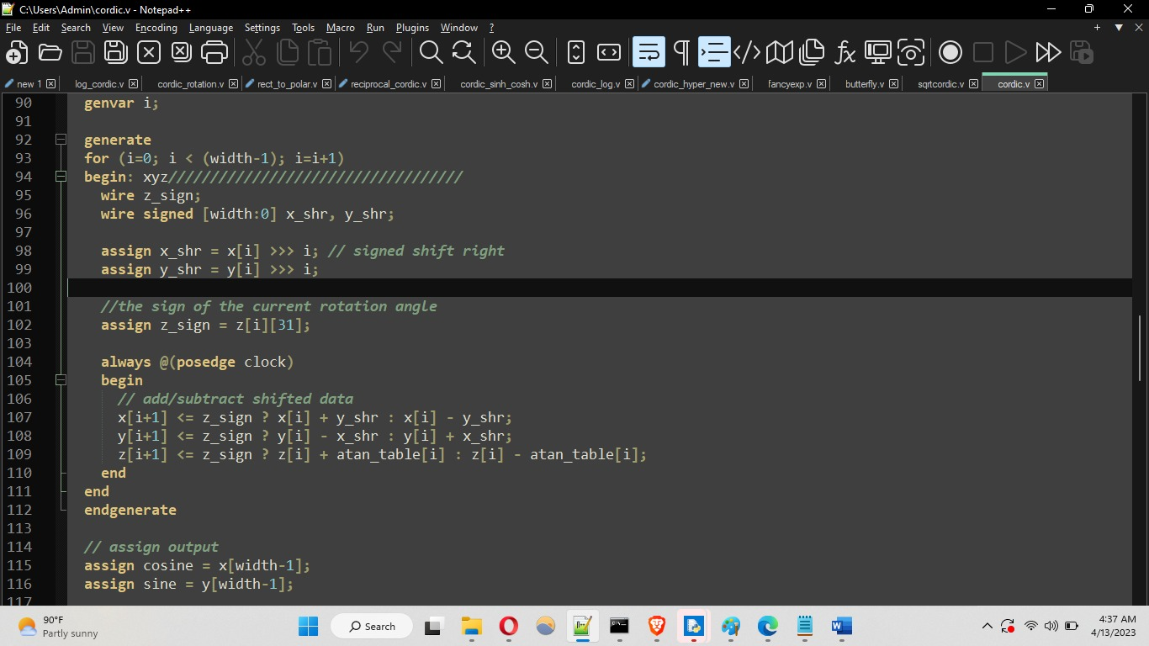
Code snippet for sine and cos

Slide 11
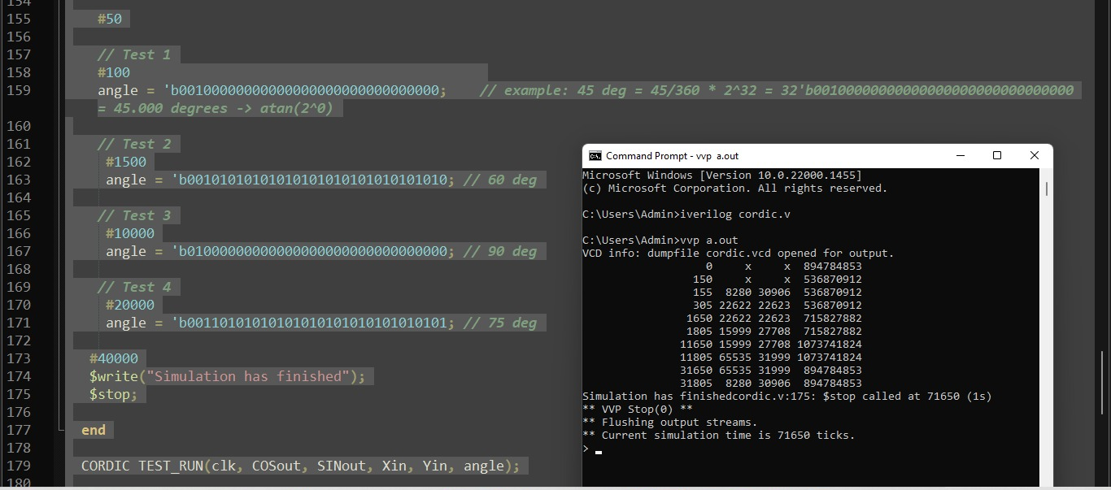
Code Snippet for sine and cos with output

Slide 12
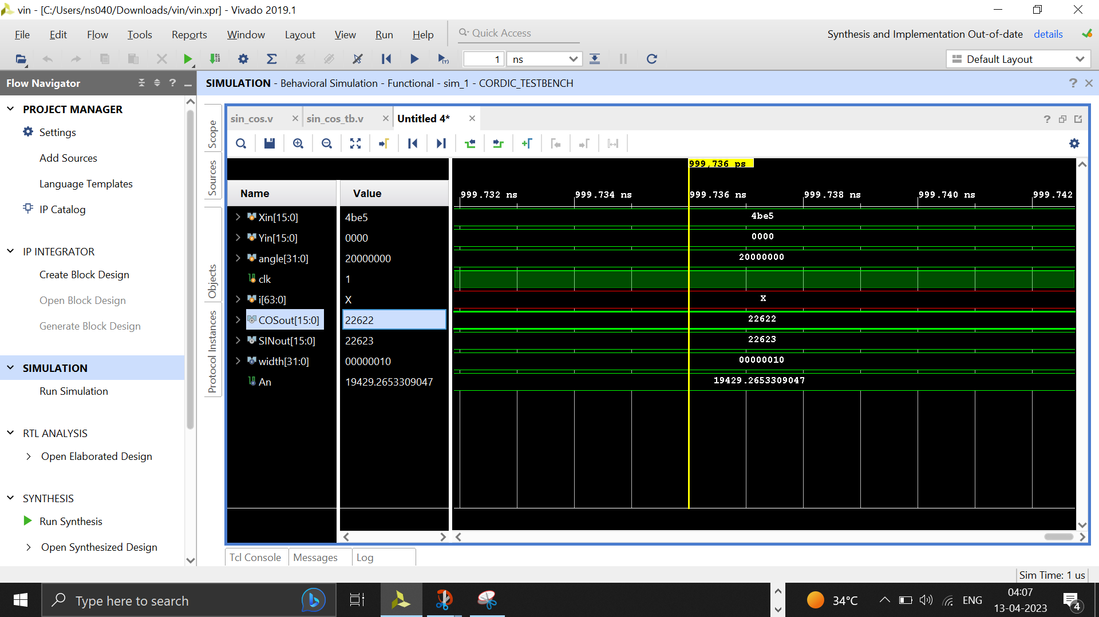
Simulation result of sine cosine function

Slide 13
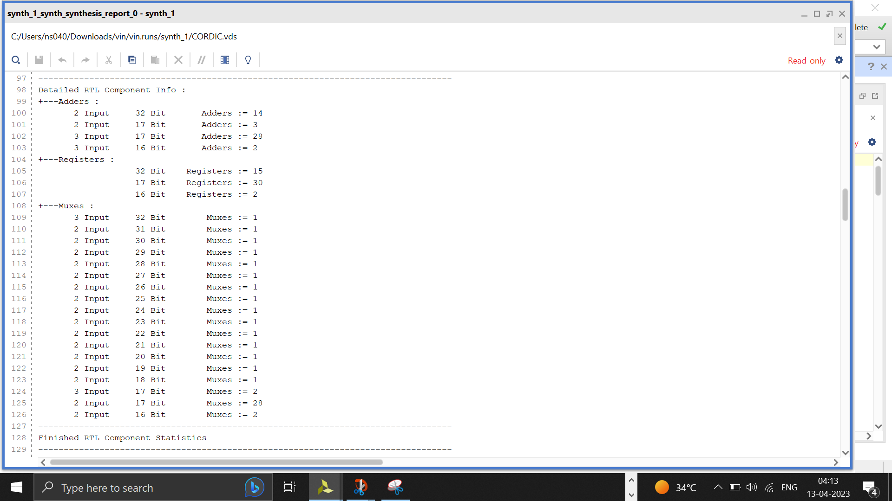
Hardware resources utilised

Slide 14
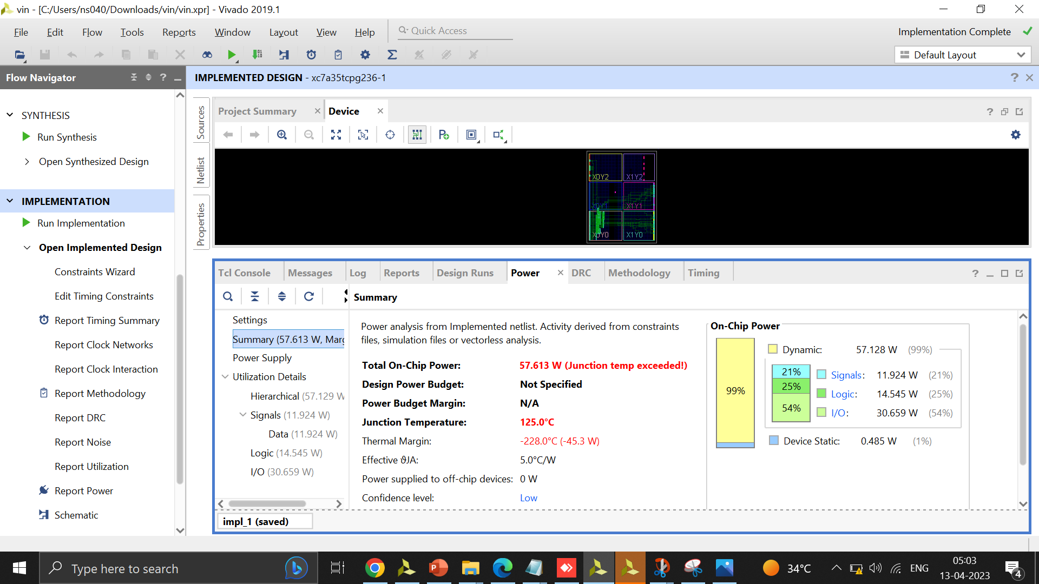
Power consumption

Slide 15
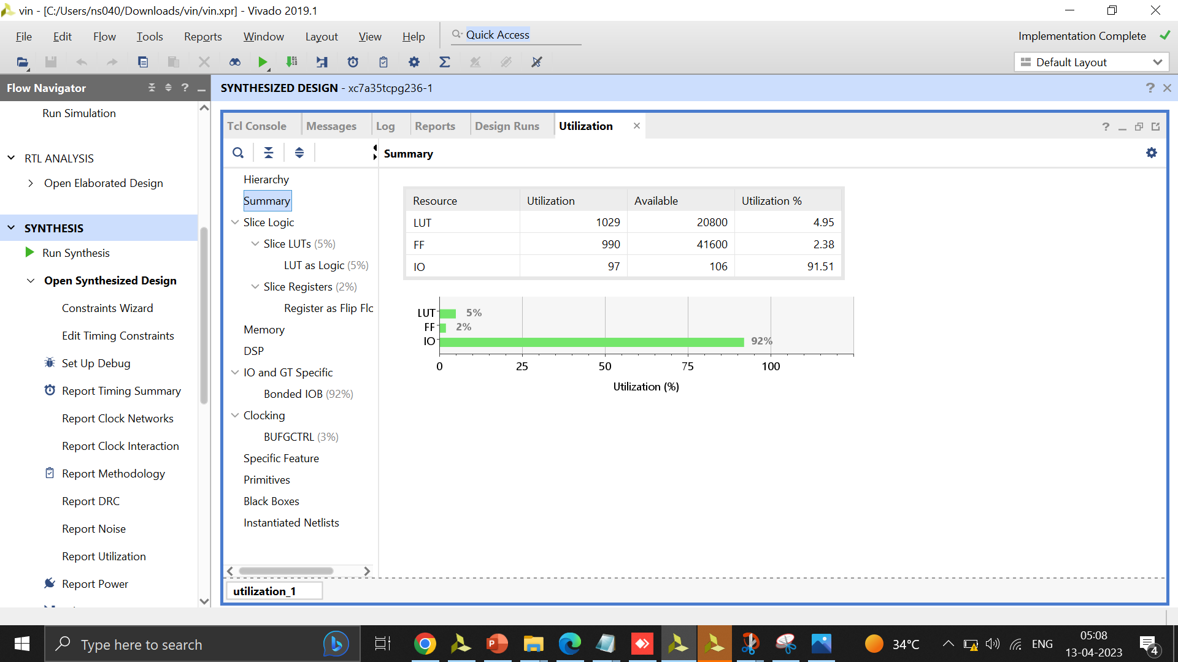
Resource utilisation

Slide 16
Discrete Fourier Transform is most power tool for performing DSP. DFT decomposes a sequence into smaller sequences and in this computation it requires arithmetic operations. It has a slow and complex computation.
X(k)is the Discrete Fourier Transform and x(n) is a sequence of samples W_{N} is called twiddle factor. Due to its complexity, Fast Fourier Transform has been proposed by Cooley and Tukey
In FFT processor, butterfly is the basic unit and using single butterfly whole computation is done. So, main concern is on butterfly unit. It comprises of Twiddle factor and complex addition and multiplication. FFT requires Nlog₂N computations. Using CORDIC in place of twiddle factor can solve the problem of complex multiplication

Slide 17
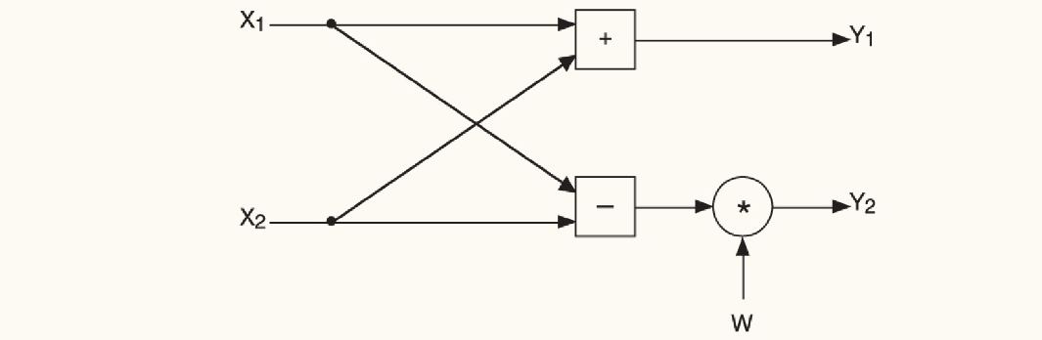
Application of Cordic : FFT
Figure : Base butterfly module
In the base butterfly module, the output corresponds to a 2 point DFT. The next figure shows many butterfly modules connected together to form the architecture for the 16 point DFT

Slide 18
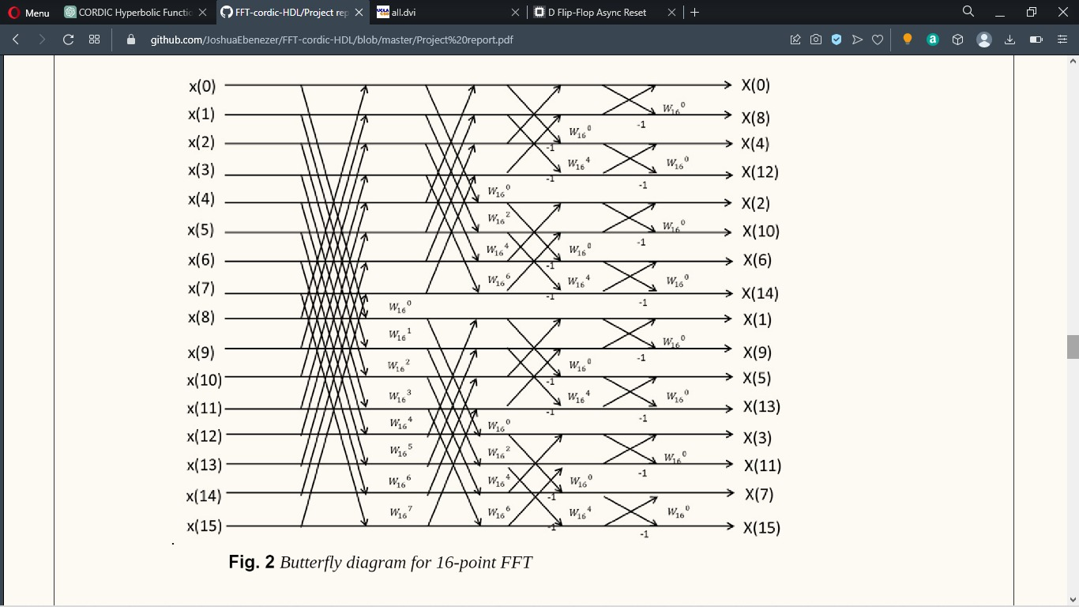
Butterfly diagram for 16-point FFT

Slide 19
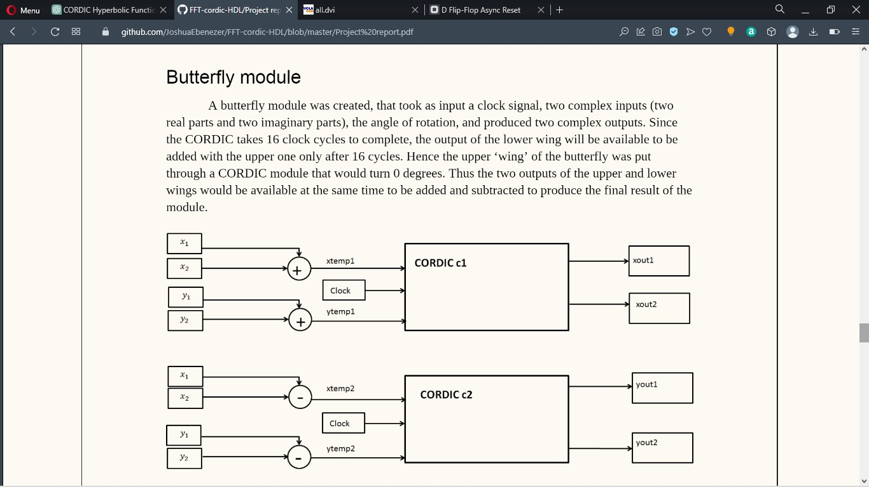
Top Module
Takes 16 clock cycles to complete
Upper ‘wing’ of the butterfly was put through a CORDIC module that turns zeo degrees.

Slide 20
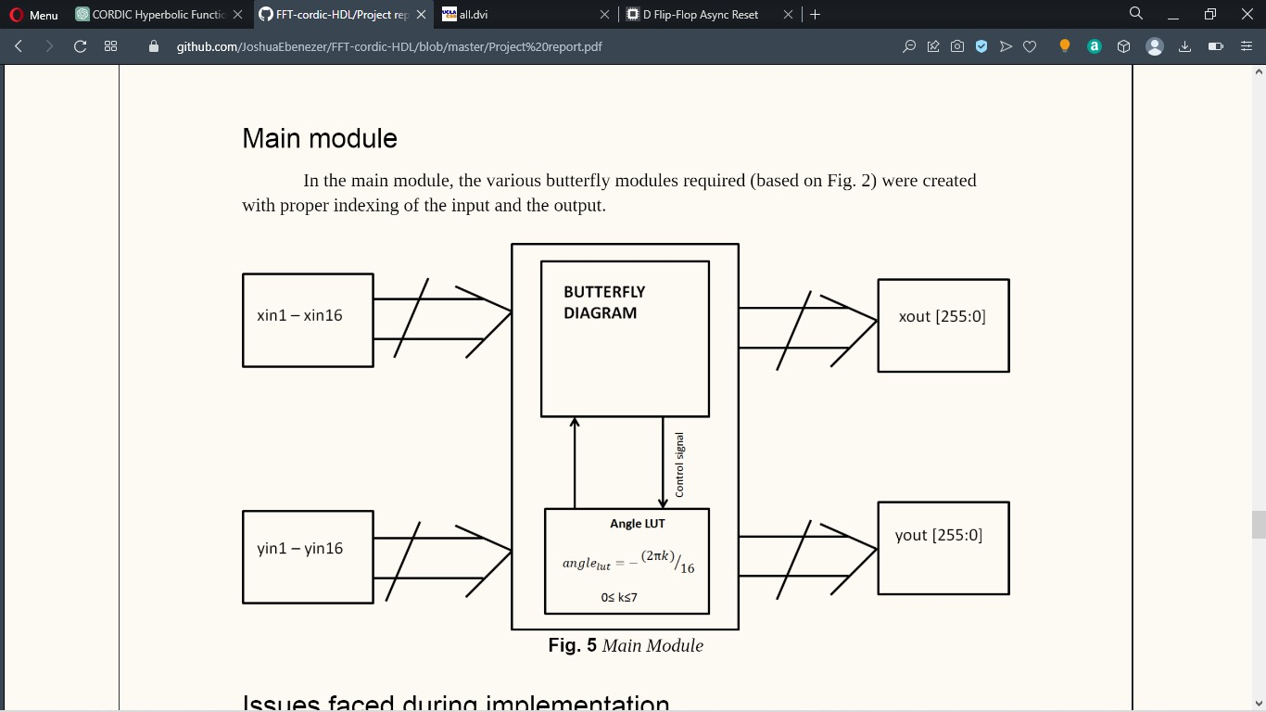

Slide 21
Scope for Future work
1. Hyperbolic functions
2.Rectangular to polar coordinates
3.3D rotation of point in space
4.logarithmic function

Slide 22
References
1. https://en.wikibooks.org/wiki/Digital_Circuits/CORD
2. unwei Li, Jiandong Fang, Bajin Li, Yudong Zhao, “Study of CORDIC Algorithm based on FPGA”, 28th Chinese Control and Decision Conference (CCDC), IEEE, 2016.
3. Supriya Aggarwa, Pramod K. Meher, and Kavita Khare, “Concept, Design, and Implementation of Reconfigurable CORDIC”, IEEE TRANSACTIONS ON VERY LARGE SCALE INTEGRATION (VLSI) SYSTEMS, VOL. 24, NO. 4, APRIL 2016
4.amanpreet Kaur, Parminder Singh Jassal, “ FPGA Implementation of CORDIC Algorithm Architecture”, International Journal of Engineering Inventions, Volume 2,Issue 10 (June 2013) PP: 39-44
5. J. E. Volder, “The CORDIC trigonometric computing technique,” IRE Transactions on Electronic Computers, vol. EC- 8, pp. 330–334, Sept. 1959
6. P. K. Meher, J. Valls, T. B. Juang, K.Sridhan and K. Maharatna, “50 Years of CORDIC: Algorithms, Architectures, and Applications”, IEEE Transactions on Circuits and Systems, Vol. 56, No.9, pp.1893-1907, 2009

